Slide 1
Final Project: Decision Trees and Employee Salaries
Jordan Baker
Data 201 - Spring 2026

Slide 2
Dataset Overview: Montgomery County Employee Salaries
Description: Annual salary information, including gross pay and overtime pay for all active, permanent employees of Montgomery County, MD, paid in calendar year 2023.
This dataset includes over 10 thousand rows and 8 columns of data. The variables include: 'Department, Department Name, Division, Gender, Base Salary, Overtime Pay, Longevity Pay, and Grade. The table below displays each variable and an example.
Q4
Dataset importance: This dataset can be to predict an employee's salary based on factors like gender and department. It can determine what departments get paid more and less, and if there is a gender wage gap in Montgomery County Employment.
.
Department | Department name | Division | Gender
“ABS” | “Alcohol Beverage Services | “ABS 85 Administration” | “F”
Base_Salary $78,957 | Overtime_Pay $456.68 | Longevity_Pay $6257.7 | Grade M2

Slide 3
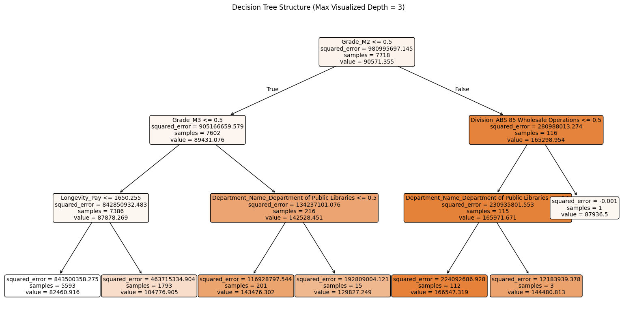
Decision Tree Model
Decision Tree w/
Max Depth = 3 Results:
Mean Squared Error (MSE): 732455528.410
R-squared (R2) Score: 0.237
Decision Tree w/
Max Depth = 5 Results:
Mean Squared Error (MSE): 579499757.156
R-squared (R2) Score: 0.396

Slide 4
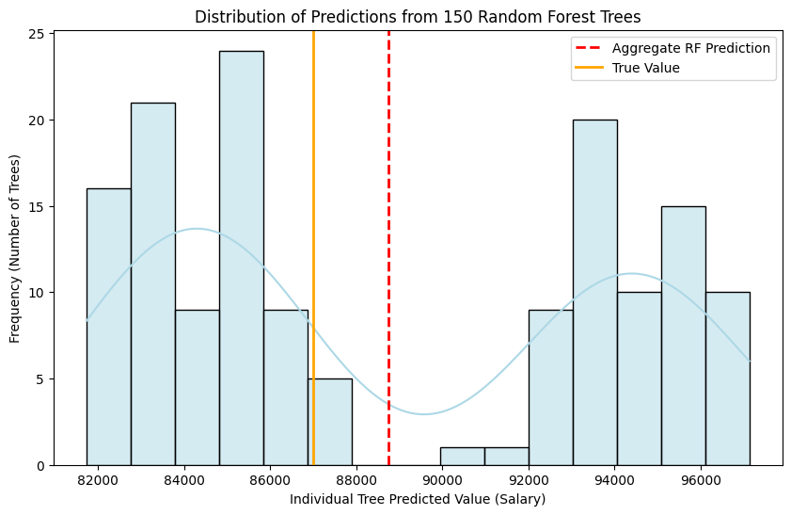
Random Forest Regressor
Random Forest Regressor w/ Max Depth = 12 Results:
Mean Squared Error (MSE): 333408639.229
R-squared (R2) Score: 0.653
- Improved MSE and R² score
- Max depth of 12 likely means overfitting
- Visualization shows high spread distribution and high standard deviation

Slide 5
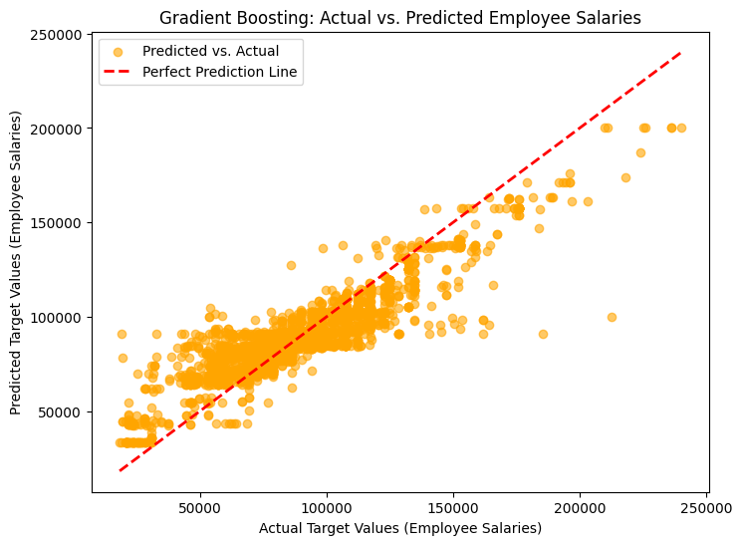
Gradient Boosting Regressor
Gradient Boosting Regressor W/
Max depth = 4 Results:
Mean Squared Error (MSE): 219972607.705
R-squared (R2) Score: 0.771
- Improved MSE and R² score
- Target max depth of 4 = reduced chance of overfitting.

Slide 6
Model Comparison & Key Findings
Decision Tree w/
Max Depth = 3 Results:
Mean Squared Error (MSE): 579499757.156
R-squared (R2) Score: 0.396
The Gradient Booster was the best model, returning the best R2 score and the lowest MSE score
I think the easiest model to explain was the initial Tree model, despite it being the least effective model.
In the real world, I would use the Gradient Booster Regressor because it was the best, as long as I had the resources to do so. If I had a time constraint, I might use the Random Forest Regression or the Decision Tree, because it is less complicated, but If I want the best results, I would use the Gradient Booster.
Random Forest Regressor w/ Max Depth = 12 Results:
Mean Squared Error (MSE): 333408639.229
R-squared (R2) Score: 0.653
Gradient Boosting Regressor W/
Max depth = 4 Results:
Mean Squared Error (MSE): 219972607.705
R-squared (R2) Score: 0.771

Slide 7
THANK YOU
Jordan Baker
Data 201 - Spring 2026

